Slide 1
IMPLEMENTATION OF A CLINICAL DECISION SUPPORT SYSTEM (CDSS) FOR CANCER WARDS
Quality improvement project report – vmhc300

Slide 2
Team MEMBERS
Mr Naidoo Max Christopher
Mr Nkanini Avela
Mr Nxam Asemahle
Mr Zide Yandisa
Mr Zolwana Saneze

Slide 3
INTRODUCTION
Background: Cancer misdiagnosis is a critical issue, often arising from human error in assessing symptoms or ordering the right tests.
Objective of CDSS: Develop a Clinical Support System (CDSS) that assists healthcare providers by providing evidence-based insights for diagnosing cancer
Expected Outcomes: Improve quality of care in cancer wards by reducing diagnostic errors, speeding up diagnosis, and facilitating better patient management..

Slide 4
QUALITY STANDARDS APPLICABLE TO THIS REPORT
Ensure the system is reliable and there are best practice methods in diagnosis and treatment.
National Cancer Control Program (NCCP)
Focusing on prevention, early detection, and accessible across the country.
Promotes healthy lifestyles, early screening, and research.
South African Nursing Council (SANC) Guidelines
Set standards for oncology nurses, who receive special training and follow ethical principles.
Support patients through informed choices and personalized care.
Encourages continuous learning to stay informed with advances in cancer care.

Slide 5
QUALITY STANDARDS APPLICABLE TO THIS REPORT
Evidence-Based Practice (EBP)
Guide nurses in decision making by combining real-life experiences, patient needs, and research
Allow nurse to tailor care for each patient while ensuring that practices are updated based on latest evidence.
Protection of Personal Information Act (POPIA)
Ensure responsibility in handling of patient data, safeguarding privacy and confidentiality.

Slide 6
THE PROBLEM NOTED
Primary Issue
Delays in the diagnosis of cancer due to the limited access to specialized services and testing equipment.
Consequences Of Delayed Diagnosis:
Prolonged pain and deterioration in the patient’s health.
Increased need for aggressive and costly treatments.
Slim chances of survival, especially in late-stage diagnoses.

Slide 7
CONTRIBUTING FACTORS
Healthcare Environment: Long wait times, insufficient diagnostic equipment, and uneven distribution of resources, especially in rural areas.
Human Resources: Limited training for healthcare providers on early cancer symptom detection.
Patient-Related Factors: Financial barriers, lack of awareness about cancer symptoms, anxiety

Slide 8
ROOT CAUSE ANALYSIS
System Issues: Delays in scheduling visits with specialists and limited access to essential diagnostic equipment.
Patient Challenges: Lack of awareness of symptoms, difficulties with transportation, and hesitancy to seek medical care.
Provider Challenges: Need for better training on symptom identification and cancer care protocols.

Slide 9
PROJECT AIM AND GOAL
Objective: Enhance diagnostic accuracy and timing in oncology
Main Goal: Reduce diagnostic errors and delays using a Clinical Decision Support System (CDSS)
Motivation: Counteract risks of misdiagnosis affecting patient health (Hall et al.)
Approach: Employ technology and evidence-based methods to improve diagnostic timeliness and accuracy.

Slide 10
SMART GOALS
Specific: Shorten diagnosis time from initial symptoms by 20% within 12 months
Measurable: Track diagnosis time before and after CDSS implementation; aim for a 20% reduction
Achievable: CDSS designed to assist practitioners with streamlined, evidence-based decision support
Realistic: 20% reduction goal is both feasible and impactful in improving patient outcomes
Timely: Target completion within 10 months (February 2024 - November 2024)

Slide 11
DECISION-MAKING CRITERIA
Feasibility: Practicality and ease of implementation
Quality Management Impact: System will improve diagnostic accuracy and support better patient outcomes
Early Detection Aid: CDSS will help patients recognize potential symptoms, encouraging timely medical consultations.

Slide 12
Selection of the best solution
Choose the best solution from the following options:
Notify symptom matches
Educate on cancer
Prompt for additional testing
EHR for patient condition
Symptom severity tracking
Decision Process:
Voting Mechanism: Each team member voted on the best solution.
Outcomes: The option with the highest points was "Notify Symptom Matches”.

Slide 13
Why "Notify Symptom Matches" Was Chosen:
Proactive Identification: Automatically flags symptoms that match patient conditions.
Prompt Diagnosis: If cancer is detected, the system suggests appropriate treatment methods or prompts referral to specialists.
Minimizing Medical Errors
Prevention of Delays: Early intervention is possible, reducing the risk of late-stage cancer diagnosis.
Higher Patient Satisfaction: By improving diagnosis accuracy and speed, patient trust and satisfaction are enhanced.

Slide 14
BENEFITS FOR PATIENTS AND PRACTITIONERS
Enhanced Awareness: Patients gain insight into symptoms, leading to earlier consultation
Support for Healthcare Providers: Simplifies symptom analysis and referral processes
Goal: Enable accurate, timely diagnoses to improve survival and reduce treatment delays

Slide 15
IMPLEMENTATION STRATEGY
Implementation consisted of two parts:
High-fidelity prototype for the CDSS.
Permission for testing
Use of a questionnaire for gathering feedback.
Implemented over a course of August till October.

Slide 16


PROCESS OF TESTING
System was presented (Annexure C).
Viewing of risk assessment
Each person was able to test it.
Questionnaires (Annexure A) were filled in.
Assessing through a rating system
Feedback and recommendations.

Slide 17
Aspects to consider
CDSS
Challenges in patient privacy
Recommendations:
Demographics
Health progression
Questionnaire
Challenges in target group
Recommendations:
Training to use the system
Raising awareness

Slide 18
evaluation
Goal of the potential impact implementing a CDSS
Achievements
Limitations/Constraints
Conclusion of implementation

Slide 19
IMPACT OF THE MANAGEMENT STRATEGY
Overview of key focus areas:
Nursing Management.
Nursing Care.
Patient Outcomes.

Slide 20
NURSING MANAGEMENT
Will Bring improvements to nursing management in cancer wards.
Provide real time alert and recommendations that are based on patient symptoms.
Empower nursing managers to make informed decisions quickly.
Encourages collaboration among nursing staff
E.g., patients presents a specific symptoms, the system will alert managers of potential issues need to be addressed before they escalate.

Slide 21
NURSING CARE
Modernize how nurses diagnose and assess patients
Access to advanced symptom analysis tools, nurses will be able to provide quick
More accurate care
E.g., if patient shows signs of distress the CDSS will offer immediate suggestions
This capability also builds stronger relationships and trust with patients.

Slide 22
PATIENT OUTCOMES
The CDSS is expected to improve patient outcomes
Features like time alerts and treatment suggestions will lead to early diagnosis
Improve survival rates
Offer personalized treatment recommendations based on symptoms anaylsed
Reduce chances of misdiagnosis

Slide 23
CONCLUSION
Implementing CDSS in oncology wards can decrease diagnostic delays and enhance patient outcomes by supporting timely symptom identification and care guidance.
CDSS offers structured data that improves decision-making and minimizes human error in cancer diagnoses.
It represents a transformative tool in healthcare, promoting early detection, effective treatment, and enhance patient outcomes, particularly in cancer care.

Slide 24
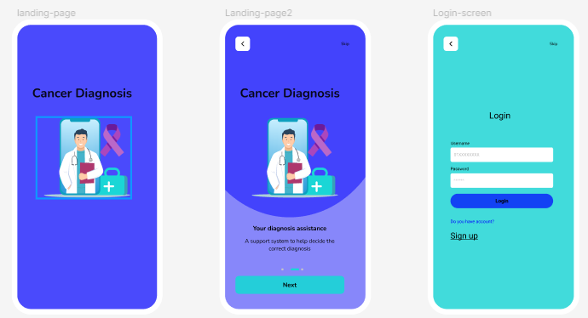
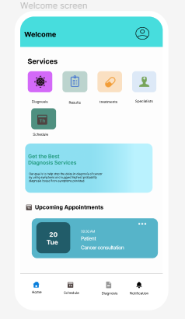
The System PROTOTYPE

Slide 25
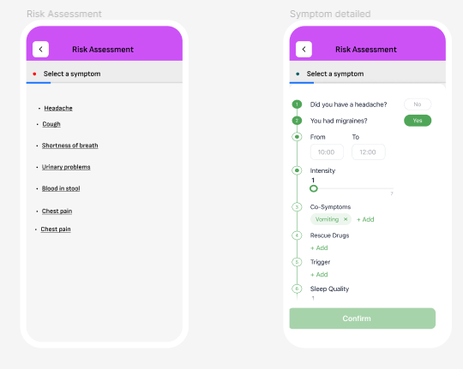
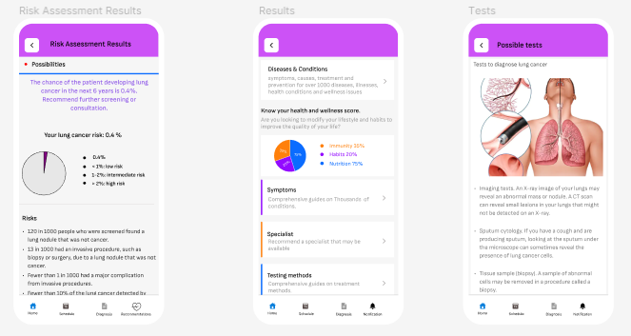
The System PROTOTYPE

Slide 26

The System PROTOTYPE

Slide 27
References
Council, S. A. (2020, June). SANC-competencies-oncology-nurse. Retrieved from South African Nursing Council: https://www.sanc.co.za/wp-content/uploads/2020/06/SANC-Competencies-Oncology-Nurse.pdf
Davids, J. M. (2006, April). Continuing professional development in nursing. Retrieved from SunScholor: https://scholar.sun.ac.za/server/api/core/bitstreams/0fcdd91b-ddf7-4732-8c7b-e9add17ff700/content#:~:text=The%20primary%20aim%20of%20continuing,to%20their%20patients%20and%20clients.
Dr. Tiffany Avery, C. M. (2020, August 31). Understanding evidence-based practice in oncology. Retrieved from Nant Health: https://nanthealth.com/resources/articles/evidence-based-practice-in-oncology/#:~:text=Evidence%2Dbased%20practice%20is%20the,clinical%20trials%20for%20similar%20diagnoses.

Slide 28

Thank you

